Slide 1
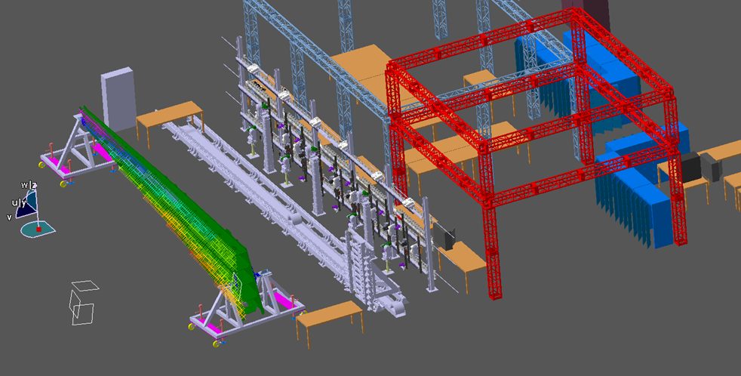
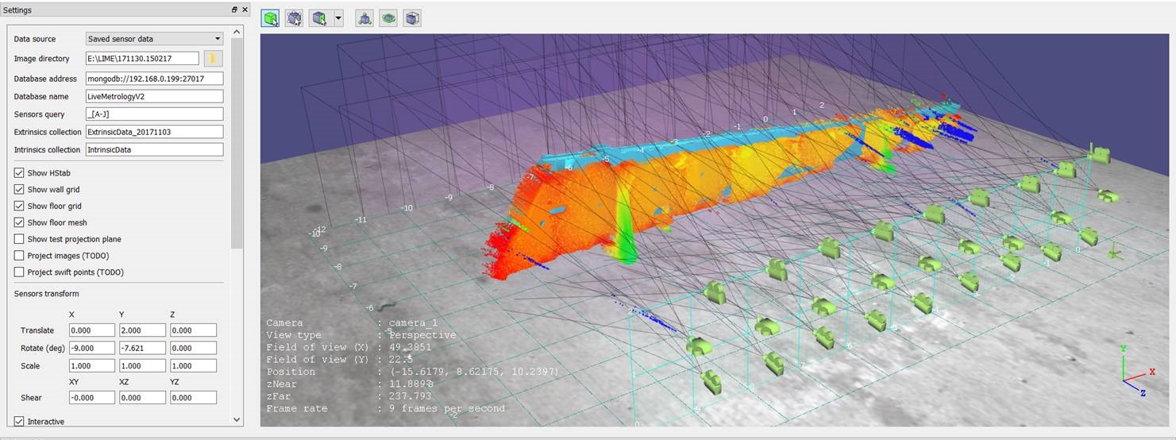
Live Metrology: Boeing Salt Lake System Integration Lab
High Level Requirement
Long-range: Generate 3D point cloud of H-stab in less than 5 minutes to 3 thou accuracy
Approach
Hierarchical Sensor Configuration
Low resolution: time-of-flight sensors provide contextual info
Medium resolution: static large FOV cameras and projectors
High resolution: Dynamic scanning sensors
Technologies
Polarized light
Structured light
Texture to increase correspondences
Encoding to limit search
Stereo + depth (Time of flight)
Shape from Shading
Surface derivatives and continuity
Global coordinate system
Highly accurate calibration process is critical

Slide 2
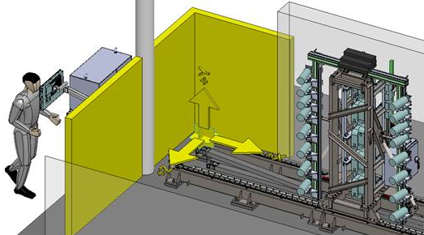
BSL Dev Cell Rail and Sensor Carriage: Overview
Located in front of static wall, which provides initial scanning conditions (context)
~14 feet distance from h-stab
46’ of travel
8 pairs of hi resolution cameras
< 2 thou resolution
12 custom IR projectors for structured light
< 8 thou resolution
12” of independent projector travel
Focus control and dynamic calibration
Time-encoded structured light technology

Slide 3
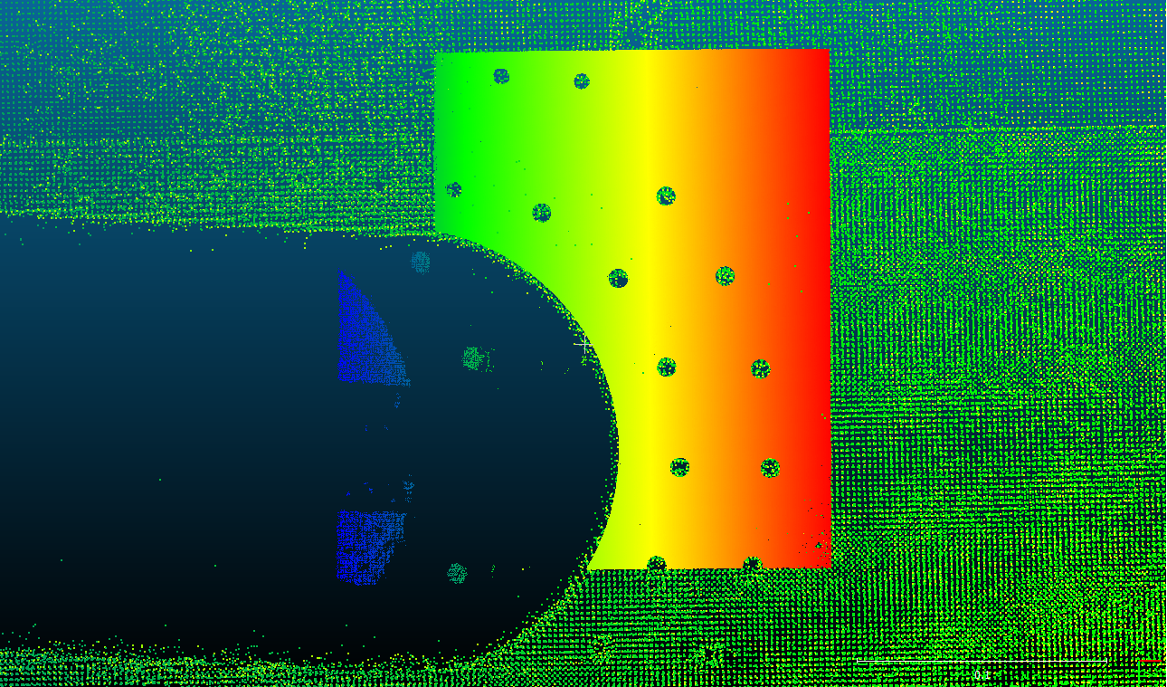
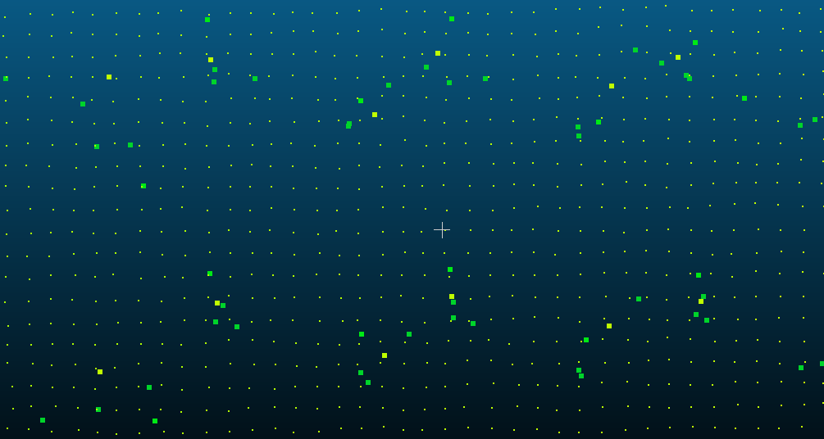
BSL Dev Cell Rail and Sensor Carriage: Technologies
Dynamic camera lens focus
Dynamic intrinsics
Process to parameterize intrinsics by focus value
Mapping focus controller states to physical values
Mobile projectors
Extrinsics relative to cameras
Mapping projector focus to encoder values
Dynamic camera extrinsics
Scanning camera extrinsics parameterized by U-value
In world coordinates defined by static wall sensors
Time-encoded structured light with image-based enhancements
Achieves < 3 thou accuracy feature detection

Slide 4
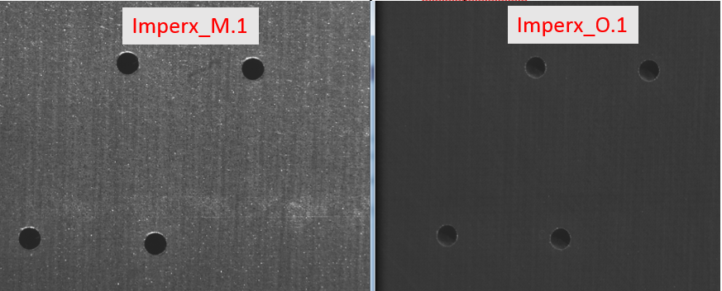
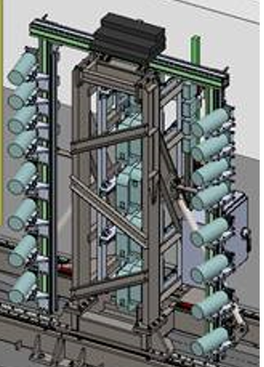
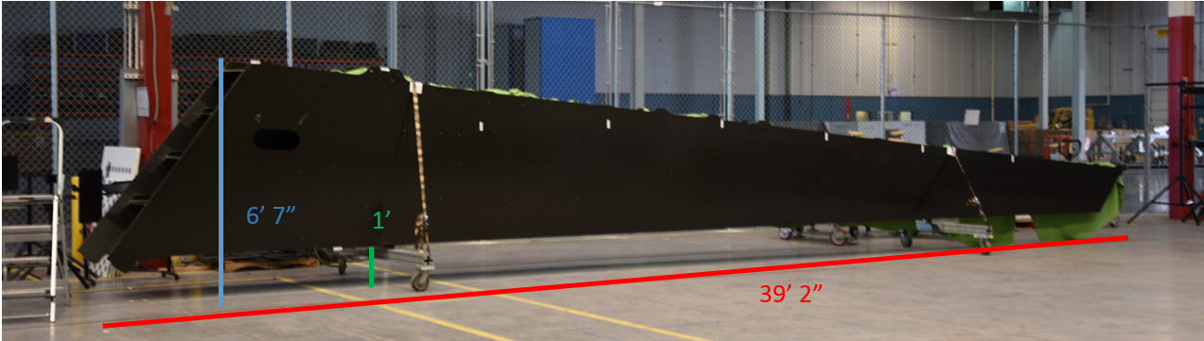
Scanning Con-Ops
Static wall calibration
Dynamic sensors focus-dependent intrinsics
Dynamic sensors –to- projector extrinsics
Dynamic sensors U-dependent extrinsics
These will be in the world frame defined by the static wall calibration
Static wall 3DU/SDF capture and 3d reconstruct
Stitch output of 5
Align as-designed mesh to output of 6
Initiate scanning at ~5” increments. At each increment:
Determine physical distance along each camera line of sight to mesh
Drive focus to appropriate state and index appropriate intrinsics
Drive projector axis to appropriate state using projector extrinsics
Capture 3DU/SDF data and send for analysis along with dynamic calibration information
Extrinsics are in the world frame, so the output point clouds will be in the world frame

Slide 5
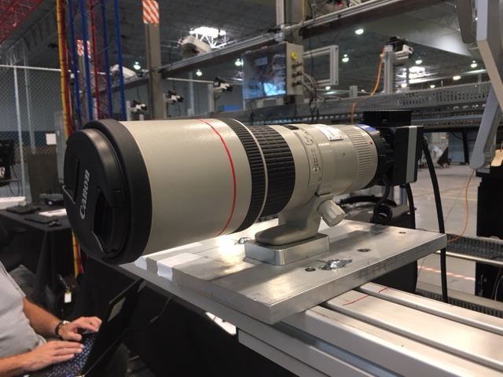
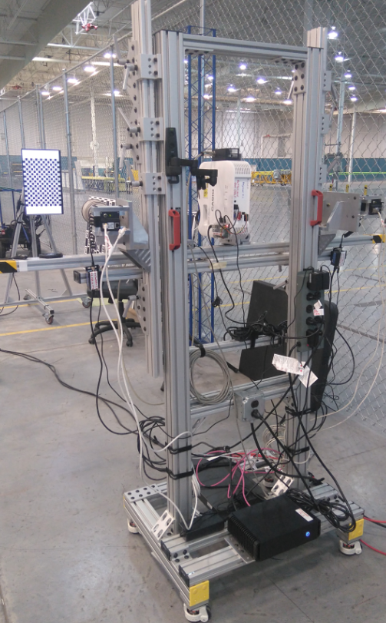
Focus Controller Integration
Given extrinsics between the scanning camera and the world, and the registered h-stab mesh in the world, determine the optimal focus state for that camera
Map focus values to physical distances along camera optical axis
Determine focus value bounds that we care about
Hold calibration board at front of h-stab and run focuser operation
Hold calibration board at back of h-stab and run focuser operation
Compute intrinsics at focus state increments of X between bounds above
Place calibration board within bounds
Run focuser operation to determine optimal focus state for current board position
Using interpolated intrinsics, estimate 3D pose of the board, unproject the principal point to 3D, and associate this distance with current focus state
Repeat steps 3 through 5 until we’re sufficiently sampled

Slide 6
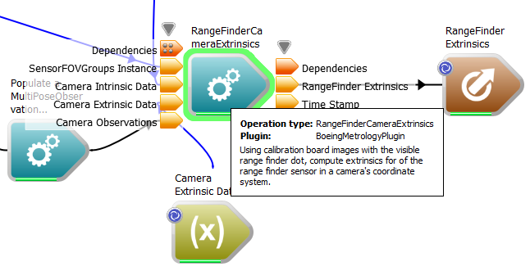
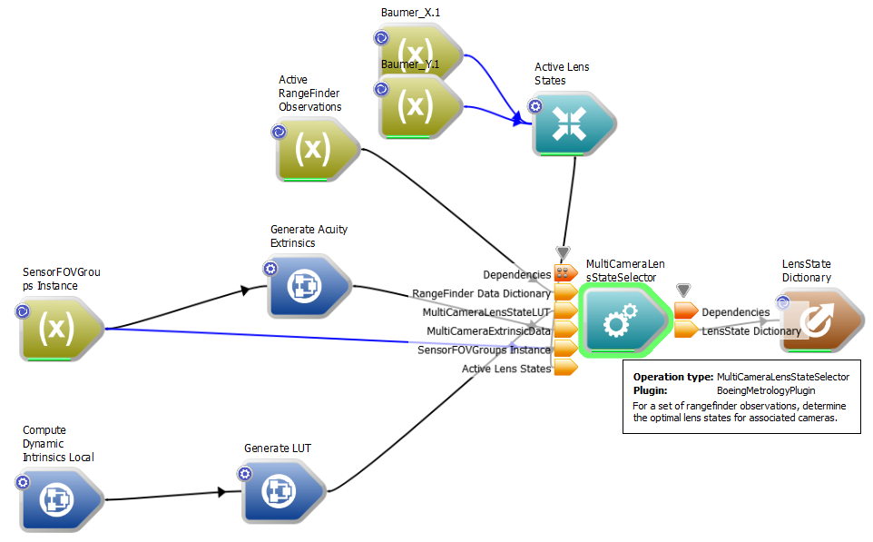
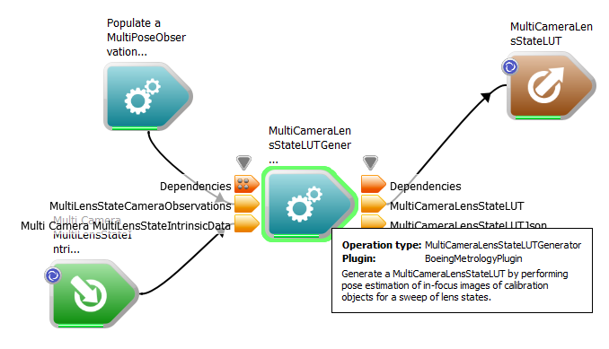
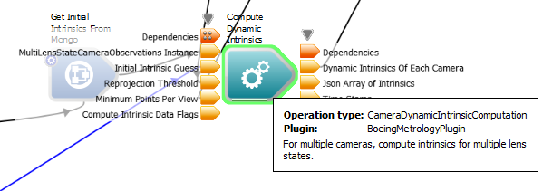
Acuity-Driven Focus Control
Class | Description
MultiLensStateCameraObservations | Pose observations for a single camera spanning multiple lens states
SensorFOVGroups | Group sensors by overlapping field of view. At most one Acuity is expected in each group. Used by Acuity extrinsics and lens state selector.
LensState | Zoom, aperture, focus state of a camera
MultiCameraExtrinsicData | Position and orientation of many cameras and Acuitys in a common coordinate system
MultiLensStateIntrinsicData | Dynamic intrinsics of a single camera. IntrinsicData objects organized LensState.
MultiCameraLensStateLUT | Physical focus distances associated with lens states for multiple cameras
Operation | Description
Focuser | Determines sharpness of a greyscale image of a black-and-white object. Decreasing metric is increasing sharpness.
CameraDynamicIntrinsicComputation | Compute IntrinsicData for multiple lens states for multiple cameras
RangeFinderCameraExtrinsics | Derive extrinsics between Acuity sensors and associated cameras
MultiCameraLensStateLUTGenerator | Determine physical focus distances that map to multiple lens states of multiple cameras. Dependent on dynamic intrinsics. Uses Focuser metric.
MultiCameraLensSelector | For a set of Acuity observations, determine the optimal lens state for each associated camera

Slide 7
Acuity-Driven Focus Control
Workflow | Description
Calibration/ MultiLensStateCalibrationIntrinsicData.wsx | Loads initial intrinsics from Mongo, computes MultiLensStateIntrinsicData for multiple cameras, and publishes those results to Mongo (one doc per camera) to the IntrinsicDataDynamic collection (note: reprojection threshold should be = 10)
Calibration/ MultiLensStateCalibrationExtrinsicData.wsx | Loads dynamic intrinsics and a set of data with only ONE LENS STATE PER CAMERA (this is a current limitation) and loads the closest intrinsics match and runs baseline extrinsic calculation.
Scanning/ GeneratorMultiLensStateLUT | Loads dynamic intrinsics from Mongo and loads pose data for multiple lens states from pose folder, generates a MultiCameraLensStateLUT, and publishes that LUT (look-up-table) to Mongo collection LensStateLUT
Calibration/ RangeFinderCameraExtrinsics.wsx | Loads dynamic intrinsics and extrinsics from Mongo, loads pose data specific to acuity and camera collections, adds range finder extrinsics to the extrinsic data, and publishes to ExtrinsicData collection
Scanning/ MultiCameraLensStateSelector.wsx | Load acuity + camera extrinsics, the lens state LUTs, reads Acuity live data, and drives each associated camera lens to the optimal state by interpolating the LUT

Slide 8
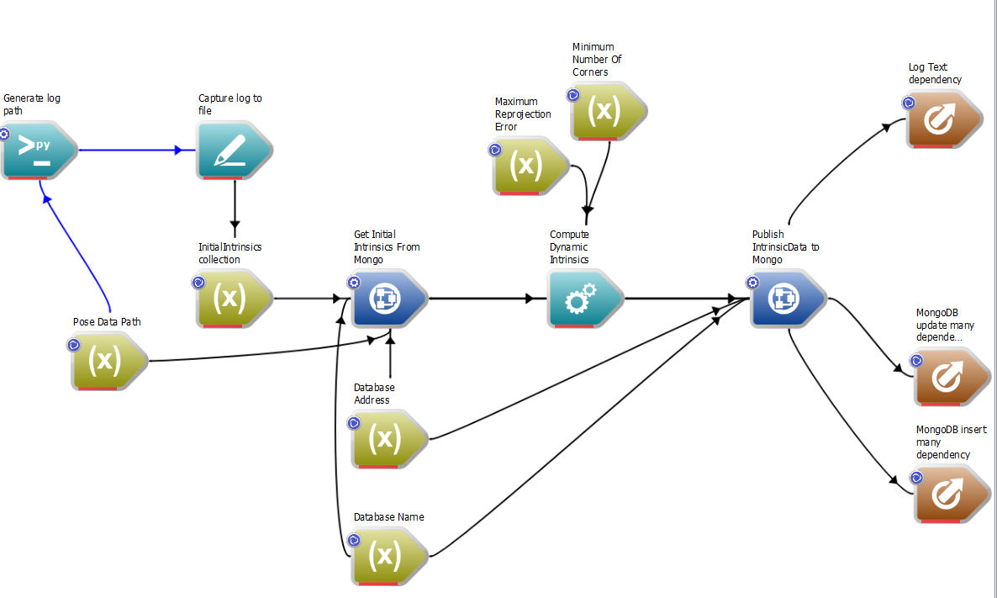
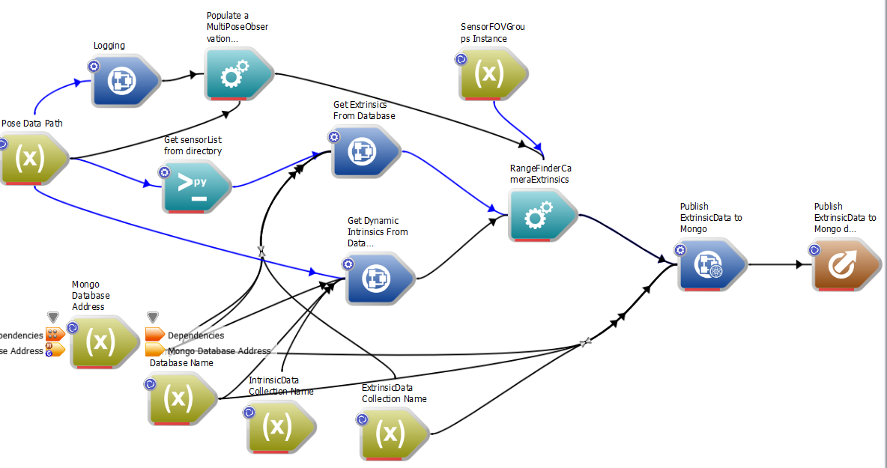
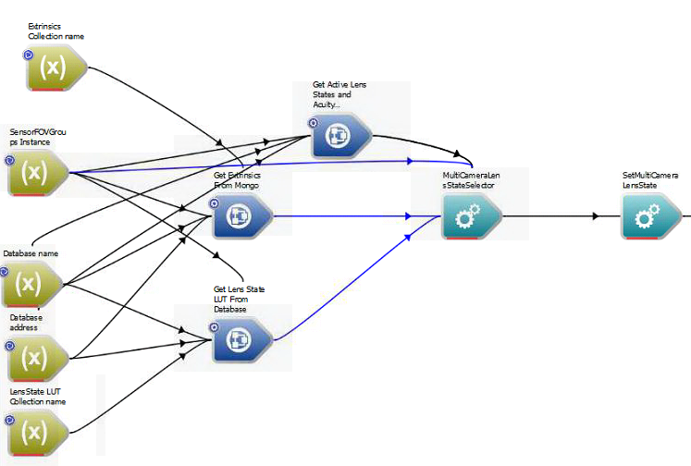
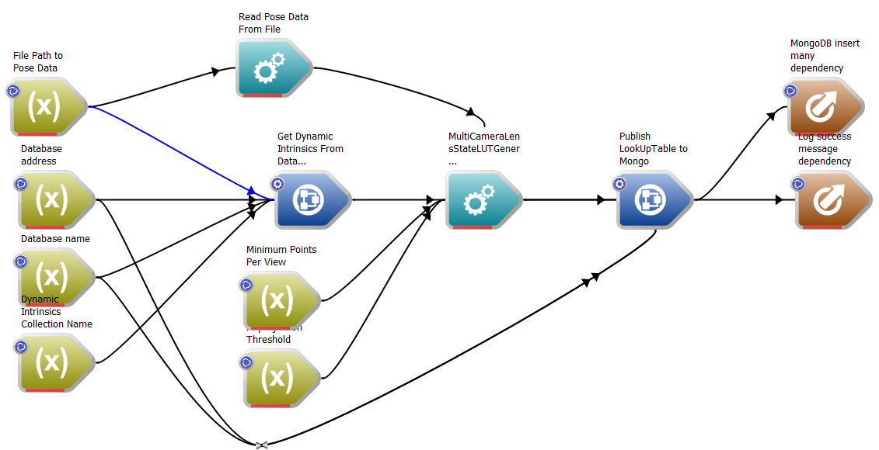
Acuity-Driven Focus Control
MultiLensStateCalibrationIntrinsicData.wsx
RangeFinderCameraExtrinsics.wsx
MultiCameraLensStateSelector.wsx
GeneratorMultiLensStateLUT.wsx

Slide 9
Mobile cart calibration process
Place 3’x2’ ChAruco board at ~14 feet (4.27m)
Determine Acuity reading at which projector is in focus (do not adjust the lens tube! Move the board instead)
You can simply look at the LED screen on the Acuity to view distance. Be mindful the setting to avoid stale/invalid readings.
Turn off Acuity laser dot (currently manual via the button on the sensor)
Drive lens states to optimal states : Run Scanning/SelectOptimalFocusState.wsx workflow
Perform intrinsics collection with board at this range (Rev 11)
Configuration: arucocalibration_36x24_baumer_physical_board.wsg
30-40 poses at all orientations
If images are too dark, turn up Analog gain or exposure time (>100000) in Baumer settings
At current range, update Rev number to create a new set of pose folders specific to Acuity calibration data (Rev 13)
Add Acuity to Sensorhub as well as Aruco app (warning; we have current collection issues with dot not aligning with capture time)
Collect a 3-5 poses moving board forward and backward +- 3 inches
Move board back ~1 meter
Remove Acuity from aruco app
Repeat steps 3, 4, and 5 at this new distance in Rev12 folder
Repeat step 6, 7 and 8 to complete Acuity extrinsics collection
Manually copy Rev_11 data into a new folder called Rev_11_12_combined
Copy Rev_12 pose folders into the combined folder
Compute dynamic intrinsics: Run MultiLensStateCalibrationIntrinsicData.wsx workflow on Rev_11_12_combined folder
Compute Baumer extrinsics: Run MultiLensStateCalibrationExtrinsicData.wsx workflow on Rev_11 folder
Compute Acuity extrinsics: Run RangeFinderCameraExtrinsics.wsx workflow on Rev_13 folder. Pop-ups will ask you to click on the closest true laser dot detection (this is to filter out potential false alarms). These detection thresholds are still a work in progress – this is an area for improvement. If this step is failing, just move onto the next step and the existing extrinsics in the database will be used.
Build look up table of physical distances to lens states: Run GeneratorMultiLensStateLUT workflow on Rev_11_12_combined folder
Verify extrinsics look sensible by running the calibration viz app from the live metrology launcher
Done
Pose Folders | Purpose
Rev 11 | Baumer intrinsics + extrinsics
Rev 12 | Baumer intrinsics
Rev 13 | Acuity extrinsics
Rev 11 + 12 combined | Baumer intrinsics

Slide 10
Mobile cart 3DU process 09/20/2018
Move cart into place such that Acuity reading is ~4.27m
Use Sensor Capture App to verify we’re viewing a feature of interest
Focus cameras: Run Scanning/SelectOptimalFocusState.wsx workflow to “auto-focus” the cameras
Visual verification of crisp images
Focus projectors: Run SelectProjectorFocusState.wsx workflow at different manual rail positions
Apply tickmarks to projector rails. At each tickmark, manually enter the rail position into the workflow and click capture button. A metric will be reported out for this rail position. When complete, the workflow will post the optimal rail position, which corresponds to the lowest focus metric value
Turn off Acuity laser dot (currently manual via the button on the sensor)
Run 3DU collection and reconstruction from C:\Program Files\csiro.au\workspace-boeingmetrology-vs2013\bin
Configuration file: Mobile Cart.xml
Parameters to optimize include
Projector intensity (0-1)
Analog gain (1-6)
Exposure time (80,000 – 200,000)
Black/white thresholds (0 / 40)
Things to look for:
Number of correspondences (number of points in cloud) to be as large as possible (>600,000)
If scanning something flat, the variance in Z to be as small as possible (we need to drive down noise in the Z-direction) (currently manual with cloudcompare)

Slide 11
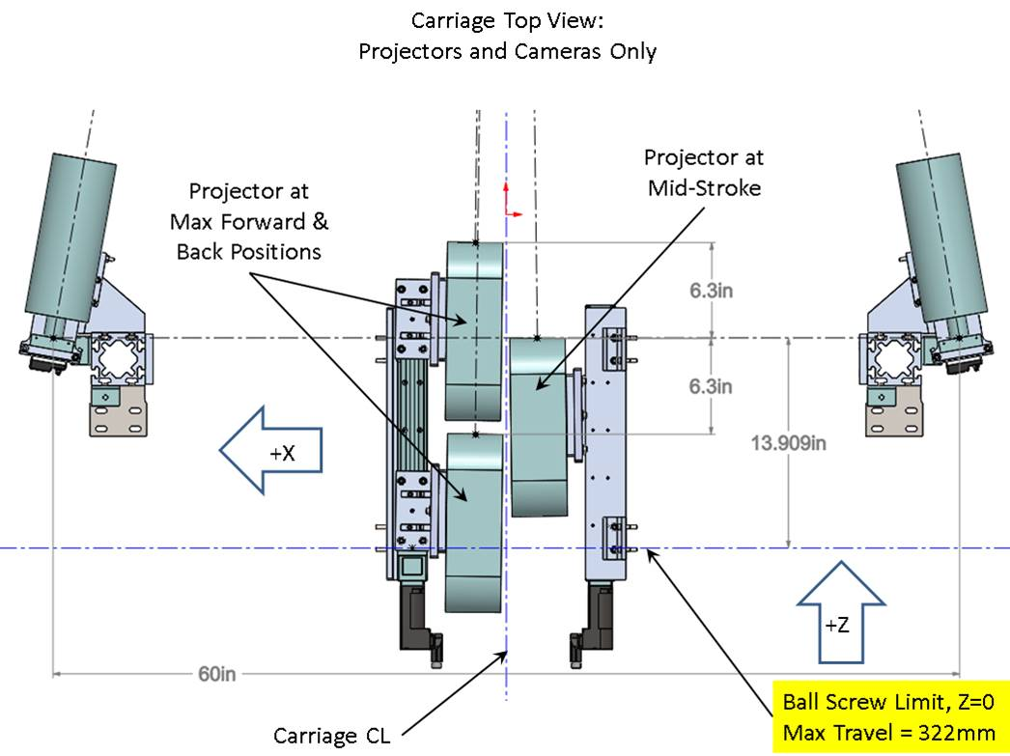
Projector Focus Integration
Given extrinsics between the scanning camera and the world, and the registered h-stab mesh in the world, determine the optimal focus state (rail position) for the projectors
Software to auto-determine optimal focus
Extrinsics between projector and scanning cameras at rail end positions
Fixed focus distance of projectors

Slide 12
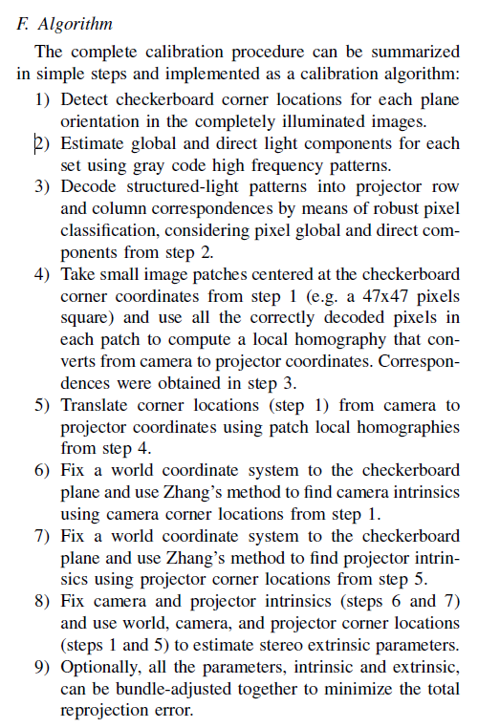
Projector extrinsics
Existing ChAruco detection
Inspired by http://mesh.brown.edu/calibration/
Collection of a full 3DU sequence on ChAruco board
OpenCV pinhole intrinsic model
We will treat projectors just like cameras as far as IntrinsicData and ExtrinsicData models
3DU output
Excerpt from source code Application.cpp void Application::calibrate(void)
Step 5 outputs chessboard corners in projector image plane. All subsequent steps treat projector just like a camera.

Slide 13
High-Level Tasks to Prepare for Linear Rail
Select cameras and lenses [LIVPLN-834, LIVPLN-760]
Maximize pixel density on surface at >= 10 fps without breaking bank
Dynamic focus
Focus controller integration [LIVPLN-851]
Dynamic intrinsics [LIVPLN-852]
Map focus controller states to physical units
Image processing to say focus is “optimal” [LIVPLN-755]
Projector focus
Projector extrinsics [LIVPLN-765]
Image processing to say focus is “optimal” [LIVPLN-763]
Acuity integration
Extrinsics with camera [LIVPLN-766]
Drive focus state in lieu of static wall info
Calibration process improvements for small DoF cameras [LIVPLN-850]
DoE process to arrive at optimal 3D reconstruction [LIVPLN-854]
Sensor geometry: Baseline between cameras
Image parameters: Aperture setting, Exposure time
Projector parameter: Image intensity
Reconstruction parameters: 3du black/white thresholds
Analysis software assessing point cloud quality
DoE cart design/assembly [LIVPLN-736, LIVPLN-832, LIVPLN-830]

Slide 14
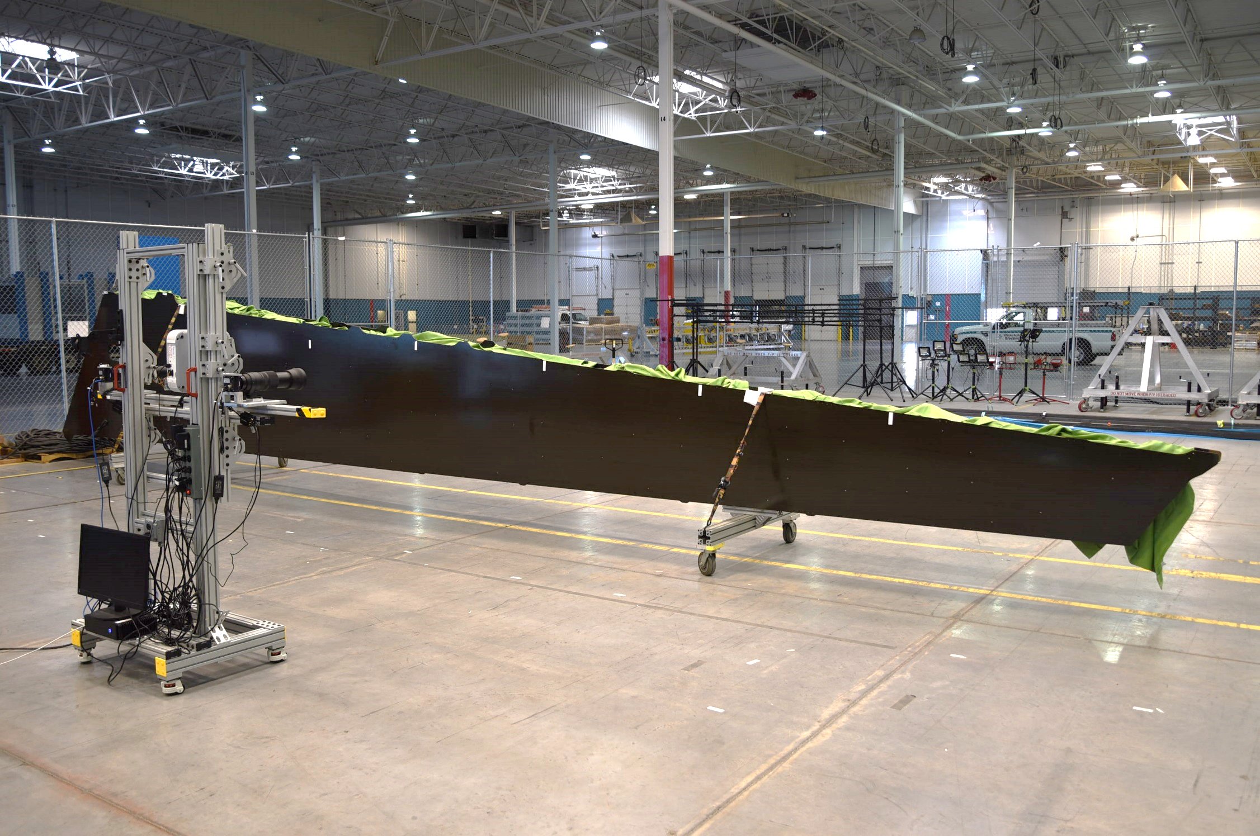
BSL Dev Cell: Replicable Structured Light Configuration
Pre-cursors
Lens selection (400 mm fixed vs zoomable to 600 mm)
Camera selection (Sony A7 vs Baumer). Data rates need to be sufficient!
Configuration
Mobile cart with lockable wheels where the cameras can be angled in and the height can be adjusted
We need to be able to maneuver until all 3 FOVs overlap at an h-stab feature where we can easily register to “truth data” (e.g. 4-hole pattern)
Will do this at multiple locations along h-stab where we can register features
2 pairs of (Baumer camera + ISSI focus controller + Canon 400 mm EF lens) rotated 90 degrees
Baseline (distance between cameras) of ~4 ft
Pixel density at 14’ is < 2 thou
3 Custom IR projector with 8” vertical field of view
Test Description
For each parameter setting
Run calibration (per focus change or angle change)
Intrinsics + extrinsics
Run 3DU collection
Visually inspect images for under/overexposure
Run 3DU 3D reconstruction
Parameters of interest (see spreadsheet)
Baseline (and therefore angle)
Projector pattern greyscale intensity
Camera/lens settings
Exposure time (in software)
Aperture state (in software; requires calibration)
3DU reconstruction thresholds
Measure of performance
Qualitative visual inspection of images
3du point cloud density
3du point cloud rms to “truth”
Mobility is important
Scan particular features for registration to “ground truth”
Sample ambient lighting at various positions

Slide 15
BSL Dev Cell: Replicable Structured Light Configuration
Test Matrix
Baseline reconfiguration is costly, and varies most slowly
Image intensity, exposure variation, and aperture setting are cheap software changes and vary most rapidly
324 states, but many will be deleted in ad-hoc fashion
E.g. if images are underexposed, then all tests with larger f-numbers coupled with lower projector intensity and lower exposure time are superfluous
.
.
.
Complete spreadsheet at:
https://casa-jira.web.boeing.com/secure/attachment/14999/SLSConfigurationTestMatrix.xlsx

Slide 16
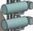

BSL Dev Cell Mobile Cart Version 2.0: Sensor Configuration
X-Y perspective
X
X
Z
Y
Y
Baumer_X.1
Projector_X.1
Baumer_X.1
Projector_X.1
Baumer_Y.1
8”
Projector_X.2
Baumer_X.2
Projector_X.2
12”
Baumer_Y.1
Projector_X.3
Baumer_Y.2
Baumer_X.2
Baumer_Y.2
All cameras rotated 90 degrees
Projector_X.3
Z-Y perspective
2’ to 5’ from floor
Z
3’ to 5’ X-spacing between cameras
Projector_X.1
Y
8”
floor
Projector_X.2
Fixed Measurements
Vertical spacing between cameras = 12”
Vertical spacing between projectors = 8”
Dynamic Measurements
Baumer_X.2 and Baumer_Y.2 range from 2’ to 5’ off floor
Distance (baseline) between Baumer_X.1[2] and Baumer_Y.1[2] ranges from 3’ to 5’
Small camera rotations about Y must be possible to get overlapping fields of view
Projector range of motion +- 6” relative to cameras along Z
Projector_X.3
12” projector range of motion along Z

Slide 17
BSL Dev Cell Mobile Cart Version 2.0: Network Devices
Imperx
Imperx
Baumer
Focus Controller
.
Baumer
.
Focus Controller
.
.
x4
.
x4
.
x8
x4
Aggregating Network Switch (PoE)
15-port switch needed
Imperx
Imperx
x3
PI
Projector
.
PI
.
Projector
.
.
x3
.
x3
.
10 Gb Uplink
https://www.raspberrypi.org/products/poe-hat/
Data PC
Main Network Switch

Slide 18

Localization via Depth Sensor
With extrinsics between Acuity and camera, we can take a depth measurement and (with simplifying assumptions), back out the focus value needed for the camera in physical units
Then need a look-up-table for associating focus states with physical focus distances
With a simplifying assumption that depth sensor and camera optical axes intersect, we can solve for d_{c} using the depth measurement and extrinsics
Final step is then to back out the focus state from the lens controller that maps to that physical distance along the camera axis
Camera
d_{c}
d_{d}
Depth Sensor
Known extrinsics

Slide 19
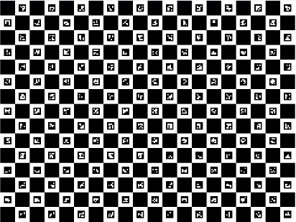
Acuity Extrinsics Methodology
Intrinsics + ChAruco capture at multiple depths
3D estimation and laser dot extraction at multiple depths
Best fit line through 3D points in extrinsics reference frame
~1 meter depth variation
Camera 1
Acuity
Camera 2

Slide 20
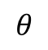
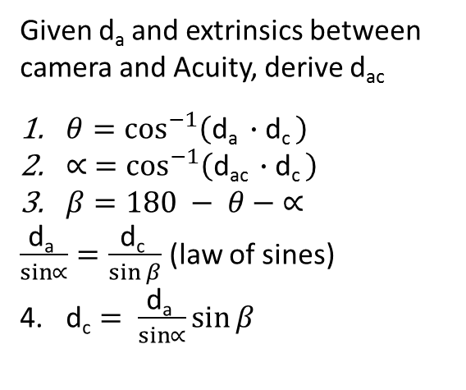
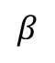

Depth Derivation
Given d_{a} and extrinsics between camera and Acuity, derive d_{ac}
$θ=\cos^{−1}\left(\text{d}\text{a} ∙\text{d}\text{c} \right)$
$∝ =\cos^{−1}\left(\text{d}\text{a}\text{c} ∙\text{d}\text{c} \right)$
$β=180 − θ−$ $∝$
$\frac{\text{d}\text{a} }{\sin{∝}}=\frac{\text{d}\text{c} }{\sin{β}}$ (law of sines)
$\text{d}\text{c}= \frac{\text{d}\text{a} }{\sin{∝}}\sin{β}$
Camera
$$θ$$
d_{c}
$$∝$$
d_{a}
$$β$$
d_{ac}
Acuity
Reference Coordinate System

Slide 21
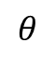
Depth Derivation Test (3-4-5 triangle)
// Baumer_X.1 as ref camera
const double pi = 3.14159265358979323846264338;
auto & by1 = multiCameraExtrinsicData_->cameraData.at("Baumer_Y.1");
cv::Mat by1trans = cv::Mat::zeros(3, 1, CV_64FC1);
by1trans.at<double>(0, 0) = 2.646;
by1.SetTranslationVector(by1trans);
double rotAboutYRad = 53.13 * pi / 180.0;
double salpha = std::sin(rotAboutYRad);
double calpha = std::cos(rotAboutYRad);
cv::Matx33d by1rot = cv::Matx33d::eye();
by1rot(0, 0) = calpha;
by1rot(0, 2) = salpha;
by1rot(2, 0) = -salpha;
by1rot(2, 2) = calpha;
by1.SetRotationMatrix(cv::Mat(by1rot));
auto & ac1 = multiCameraExtrinsicData_->cameraData.at("Acuity_X.1");
cv::Mat ac1trans = cv::Mat::zeros(3, 1, CV_64FC1);
ac1trans.at<double>(0, 0) = -1.354;
ac1.SetTranslationVector(ac1trans);
rotAboutYRad = -36.87 * pi / 180.0;
salpha = std::sin(rotAboutYRad);
calpha = std::cos(rotAboutYRad);
cv::Matx33d ac1rot = cv::Matx33d::eye();
ac1rot(0, 0) = calpha;
ac1rot(0, 2) = salpha;
ac1rot(2, 0) = -salpha;
ac1rot(2, 2) = calpha;
ac1.SetRotationMatrix(cv::Mat(ac1rot));
//Calibration::MultiCameraExtrinsicData temp(*multiCameraExtrinsicData_);
//temp.RedefineReferenceCamera("Acuity_X.1");
//// Verify. The dot product between a camera's optical axis and the vector from that camera to another camera
//// should remain the same.
//cv::Point3d beforeby1zaxis = multiCameraExtrinsicData_->cameraData.at("Baumer_X.1").GetOpticalAxisVector();
//cv::Point3d beforevecFromby1Tobx1 = multiCameraExtrinsicData_->ComputePositionVectorBetweenCameraPair("Acuity_X.1", "Baumer_X.1");
//double beforeRefChange = beforeby1zaxis.ddot(beforevecFromby1Tobx1);
//double beforeRefChange2 = beforeby1zaxis.ddot(multiCameraExtrinsicData_->cameraData.at("Acuity_X.1").GetOpticalAxisVector());
//cv::Point3d afterby1zaxis = temp.cameraData.at("Baumer_X.1").GetOpticalAxisVector();
//cv::Point3d aftervecFromby1Tobx1 = temp.ComputePositionVectorBetweenCameraPair("Acuity_X.1", "Baumer_X.1");
//double afterRefChange = afterby1zaxis.ddot(aftervecFromby1Tobx1);
//double afterRefChange2 = afterby1zaxis.ddot(temp.cameraData.at("Acuity_X.1").GetOpticalAxisVector());
//std::cout << beforeRefChange2 << ", after = " << afterRefChange2 << std::endl;
//std::cout << beforeRefChange << ", after = " << afterRefChange << std::endl;
//return true;
multiCameraExtrinsicData_->RedefineReferenceCamera("Baumer_Y.1");
double zDistance;
multiCameraExtrinsicData_->ComputeDepthAlongCameraZ({ "Acuity_X.1", 3.0 }, "Baumer_X.1", zDistance);
std::cout << "Baumer_X.1 " << zDistance << std::endl;
multiCameraExtrinsicData_->ComputeDepthAlongCameraZ({ "Acuity_X.1", 3.0 }, "Baumer_Y.1", zDistance);
std::cout << "Baumer_Y.1 " << zDistance << std::endl;
return true;
$$θ$$
4.0
Baumer_Y.1
2.4
2.646
3.0
36.87 deg
Baumer_X.1 (ref camera)
53.13 deg
1.354
Acuity_X.1

Slide 22
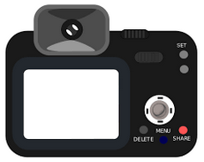
Dynamic Intrinsics
X_{V}
Y_{V}
We have empirically determined that camera intrinsics vary with focus and aperture change
If we need to compute intrinsics at 1 cm increments and have up to 1 foot of travel, that’s 30 sets of intrinsics per camera
At each focus state
> 30 poses
Wide variety of board orientations relative to camera
Sufficient coverage of observations in the corners of the images
Motion system requirements
Hold 1’x1’ poster board (~2 lbs)
3DOF rotations (about board center)
Z-axis travel up to 1 foot (along camera line of sight)
Focus State 13.5’ < Z < 14.5’
X
Y

Slide 23
Hierarchical Extrinsic Approach - Resolution-based calibration
3
4
1
2
Z_{world}
Baumer
Imperx
Nikon
Baumer
Swift
Imperx
X_{world}
Nikon
Construct pose graph of group 1
Optimize pose graph of group 1
Merge optimized pose graph of group 1 with pose graph of group 2
With locked group 1 camera vertices, optimize merged pose graph
Repeat 3 and 4 until all groups are complete
Transform to world frame
Y_{world}
Swift

Slide 24
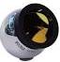
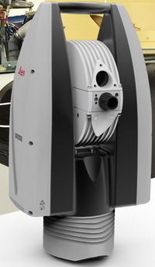
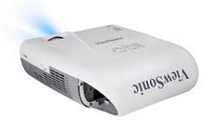
BSL Dev Cell: Vision-Based Calibration of Scanning Cameras - Determining U-Value Sampling Requirement - Determining Repeatability
Z_{lt}
X_{lt}
.
.
.
~x10
Y_{lt}
.
.
.
Z_{c000}
X_{c000}
U-value | Target 1 XYZ | Target 2 XYZ | Target 3 XYZ | Target 4 XYZ
0 | Rep 1
1
2
3
… N
0 | Rep 2
1
2
3
… N
 | …
.
.
.
45’ Carriage
Z_{world}
Y_{c000}
~x10
X_{world}
Z_{c100}
X_{c100}
Y_{c100}
Y_{world}

Slide 25
BSL Dev Cell: Vision-Based Calibration of Scanning Cameras - Complete Connectivity Graph and Associated U-values
X_{V}
Assumption
Extrinsics are repeatable or can be tabulated as a function of temperature, etc
4’x4’ board with 40x40 squares
8”
Y_{V}
8”
8”
.
.
.
8”
~x10
8”
.
.
.
Z_{c000}
X_{c000}
Vertical overlap ~0.75/2”
Scanning Calibration Process
Observe pose 0 with a “world” camera
At U = 0, observe pose 0 with cameras 0-4
At U = 7.25”, observe pose 0 with cameras 0-4
…
At U = 7.25*4, observe pose 0 with cameras 0-4
At U = 7.25*4, observe pose 1 with cameras 0-4
At U = 7.25*5, observe pose 1 with cameras 0-4
…
At U = 7.25*M, observe pose N with cameras 0-4
At U = 0, observe pose N+1 with cameras 5-9
At U = 7.25, observe pose N+1 with cameras 5-9
…
Build pose graph in reference frame of camera 0 at U = 0
Transform the pose graph into the “world frame”
.
.
.
45’ Carriage
Z_{world}
Y_{c000}
~x10
X_{world}
Z_{c100}
X_{c100}
7.25” center-to-center spacing
Y_{c100}
Y_{world}
Methodology: Construct the pose graph entirely with high-res cameras. Only transform to world frame (requiring low-res camera) after the rigid pose graph is created.

Slide 26

BSL Dev Cell: Vision-Based Calibration of Scanning Cameras - Connectivity Graph Along U Axis
Pose 0
Pose 1
Pose 2
World Observation
…
Z_{world}
X_{world}
Y_{world}
Observation 0
Observation 5
Observation 10
…
Observation 4
Observation 9
Observation 6
…
Observation 11
Z_{c000}
X_{c000}
Z_{c000}
X_{c000}
Z_{c000}
X_{c000}
Z_{c000}
X_{c000}
Z_{c000}
X_{c000}
Y_{c000}
Y_{c000}
Y_{c000}
Y_{c000}
Y_{c000}
U = 0 ….
U = 4*7.250
U = 5*7.250 …
U = 9*7.250
U = 10*7.250
Reference scanning camera frame (U = 0)
Methodology: Construct the pose graph entirely with high-res cameras. Only transform to world frame (requiring low-res camera) after the rigid pose graph is created.

Slide 27
BSL Dev Cell: Vision-Based Calibration of Scanning Cameras - Vertical Camera Spacing
X_{V}
3 poses for connected graph
X_{world}
Y_{V}
X_{V}
Z_{world}
Y_{V}
Y_{world}
X_{V}
Y_{V}
*depth to target not shown to scale
7.25”

Slide 28
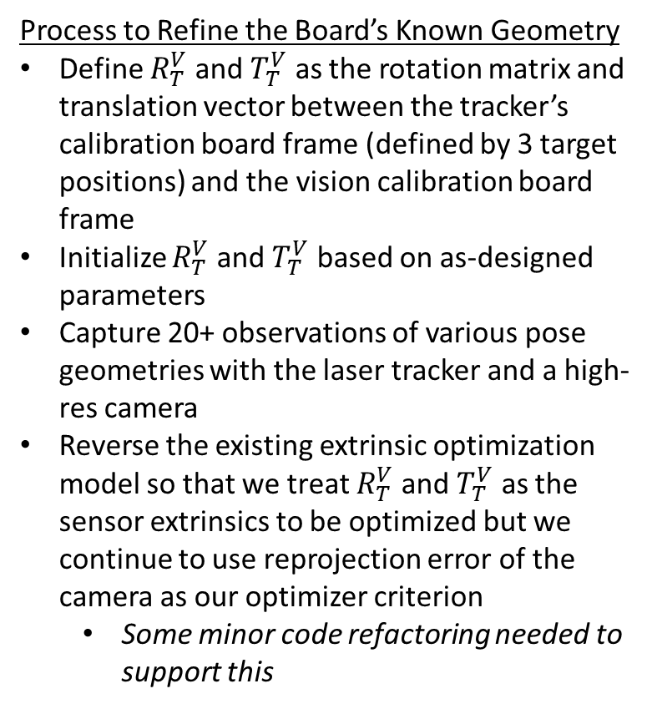
BSL Dev Cell: Supplementing Vision-Based Calibration of Scanning Cameras with Laser Tracker Data: Part I
Combined Vision + Laser Calibration Object
Process to Refine the Board’s Known Geometry
Define $R_{T}^{V}$ and $T_{T}^{V}$ as the rotation matrix and translation vector between the tracker’s calibration board frame (defined by 3 target positions) and the vision calibration board frame
Initialize $R_{T}^{V}$ and $T_{T}^{V}$ based on as-designed parameters
Capture 20+ observations of various pose geometries with the laser tracker and a high-res camera
Reverse the existing extrinsic optimization model so that we treat $R_{T}^{V}$ and $T_{T}^{V}$ as the sensor extrinsics to be optimized but we continue to use reprojection error of the camera as our optimizer criterion
Some minor code refactoring needed to support this
X_{V}
Y_{V}
Y_{T}
X_{T}
Z_{lt}
X_{lt}
Y_{lt}

Slide 29
BSL Dev Cell: Supplementing Vision-Based Calibration of Scanning Cameras with Laser Tracker Data: Part II
X_{world}
Combined Vision + Laser Calibration Object
X_{V}
Process
From Part I we have a calibration board with known XYZIJK between vision board and tracker SMRs
Generate a pose graph between cameras and vision board as shown in previous slides
Generate a pose graph between the laser tracker and the calibration board
Transform this pose graph from the laser tracker frame to the reference scan camera frame based on a shared pose observation
Perform extrinsics optimization to minimize rms reprojection error on the combined poses
Z_{world}
Y_{V}
Y_{world}
Y_{T}
X_{T}
Z_{lt}
X_{lt}
7.25”
Y_{lt}

Slide 30
BACKUP

Slide 31
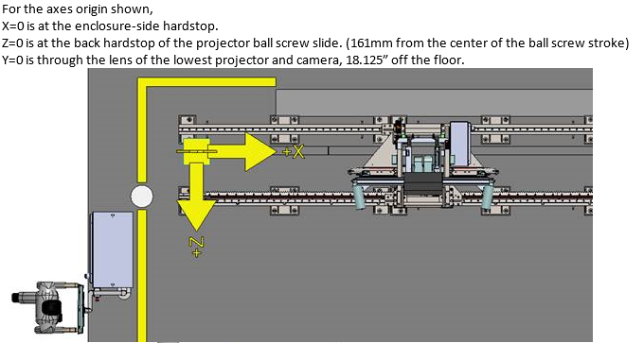
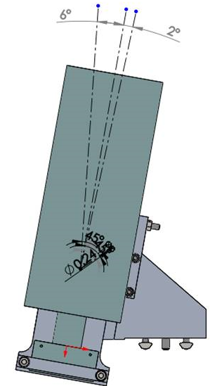
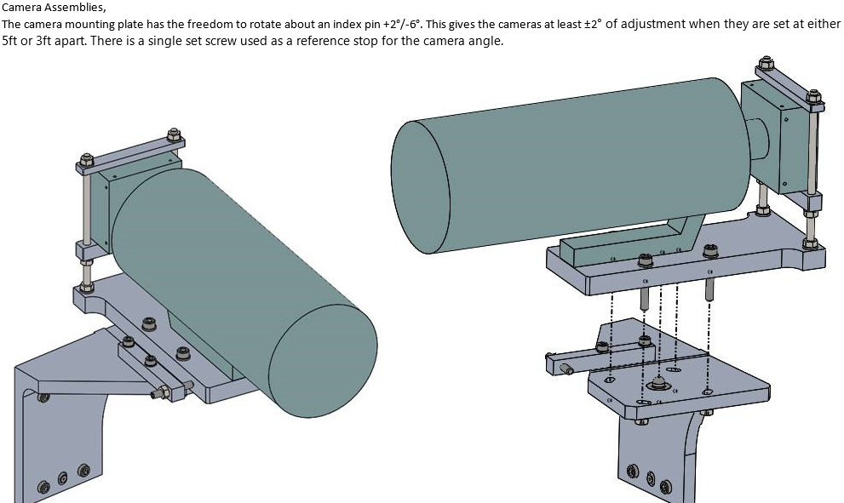

Slide 32
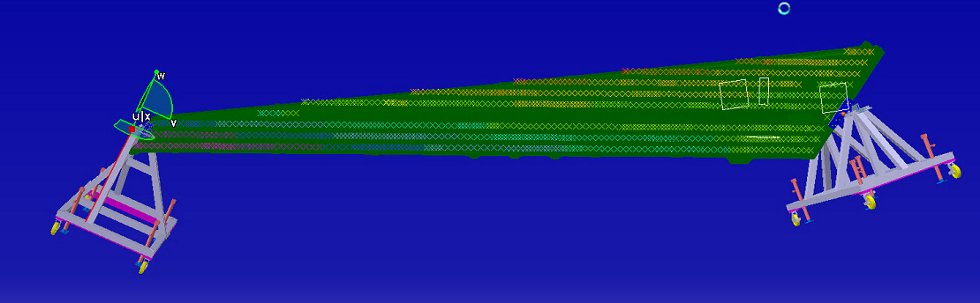
Decisions
Where to place 40” projectors to do structured light at corners of h-stab in 2 orientations
How high does bottom row of sensors need to be off the ground for the linear rail carriage
This needs to be decided SOON
Should be driven by production tooling
Modify dev cell tooling accordingly

Slide 34
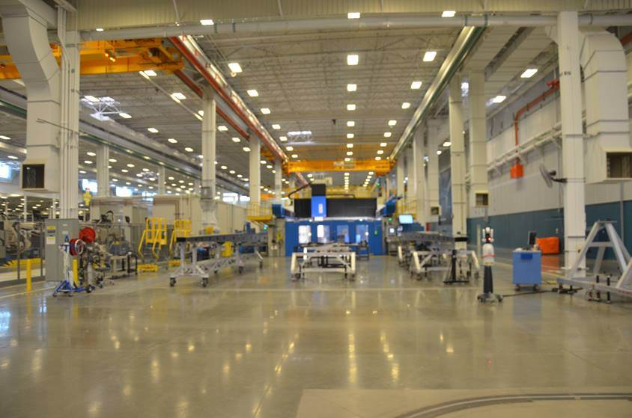
Area of interest
Top down floor view
T&D cell
Open area (“Area A”)
Area A
DAF install on tip and root, done manually
Laser shoot for spar waviness and profile.
3 hr/box, done every 2 days

Slide 35
Column
TOP DOWN VIEW
5
-
Axis Mill
–
Trim
&
Drill
#
2
10ft (6ft wide hstab and 2ft wide walking perimeter)
50 ft. center to center column distance
WCC
DON
640
28ft
17ft
walkway
Allowed to come 10ft into aisle
2ft
Rail with column of sensors
1ft
Sensor wall
Overall LiVe coverage: ~50ftx28ft
50 ft. center to center column distance

Slide 36
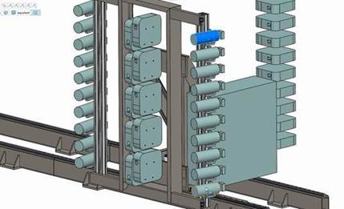
Carriage Sensor Package
10 projectors spaced 8” vertically
7 cameras spaced 11” vertically (rotated 90)
14 monochrome dual-GigE Baumer (48 megapixel)
14 ISSI LC-2 focus controllers
14x GigE cables
14x power
10 Custom IR projectors 8” at 14’ (TBD)
10 Raspberry Pi
10 hdmi (Pi to projector)
10 GigE (switch to Pi)
14 Canon 400mm lens (TBD)
High Throughput Network Switch > 28 port
Aggregating;
PoE
Low Throughput Network Switch > 26 port
Network switch (57 ports including projector rail controllers)
Should support PoE for Baumers
Embedded PC (NUCs)
Carriage should still have flexibility to add USB-3 or serial devices
E.g. 7 Acuity sensors
Hardware trigger support
Pi (Ethernet back to main switch)
Serial connection to Wonder Gecko
Wonder Gecko x2
Trigger circuit
7 cameras spaced 11” vertically (rotated 90)

Slide 37
Carriage Sensor Package
Projector_Y.5
Projector_X.5
Baumer_Y.N
Baumer_X.N
…
Baumer_Y.2
Baumer_Y.1
…
Baumer_X.2
Baumer_X.1
Projector_Y.1
Projector_X.1

Slide 38
Carriage Devices
Hardware Trigger Box
Imperx
Imperx
Baumer
Focus Controller
.
Baumer
.
Focus Controller
.
.
x14
x14
x28
.
.
x14
High Throughput Switch (Aggregating; PoE)
Imperx
Imperx
Low Throughput Network Switch (PoE)
PI
Projector
x10
.
PI
.
Projector
Notes
Baumers are PoE
28 ports on camera network switch
26 ports on other network switch
10 Projectors on PDU
.
.
x10
x10
.
.
x1
Real-Time Trigger with Pi
x2 10 Gb Uplink
x1
PDU
- Remote on/off
x10
Data PC
(for safety)
Main Enclosure
Main Network Switch

Slide 39
Lens Considerations
400 mm |  | 400-600 mm
Pros | Cons | Pros | Cons
DoF | Target Distance | Target Distance | DoF
LC-2 stability | LC-2 nearest focus at 12’ ??? |  | LC-2 stability
General Quality |  |  | General Quality
Camera compatibility (if we were to avoid LC-2)
Baumers with 400 mm Canon
1.6 thou at 12 feet with FOV 13"x10"
2.0 thou at 14 feet with FOV 15"x11.5"
Baumers with 600 mm Sigma
5/7 * 1.5 thou at 17 feet with FOV 7”x7”
Extrapolated from ImperX. We would zoom out to hit 14” FOV at 14 feet

Slide 40
Baumer Coverage at 14’
6ft = 72000 thousandths
= 51428 pixel at 1.4 thou spacing
67 + 2 inches + (+1/2*numCamera) = 72000 thousandths
= 47368 pixel at 1.52 thou spacing
Gives about 1.52 thou with 6 camera pairs at 7900x6000 ish resolution
Given that lens can achieve this
Each Imperx is responsible for 12000 thou

Slide 41
BSL Dev Cell: Structured Light Configuration
.
.
.
Notes
Nominal baseline is 4 feet
2 feet between Imperx and projector
Brackets must be adjustable to rotate +- 5 degrees around X_{world} and Y_{world}
Large baseline pros
Minimizes projector glare
Improves triangulation
Large baseline cons
Depth of focus issue
Carriage mount?
Overlapping SLS patterns
Additional timing constraints
Imperx
.
.
.
12”
projector
.
.
.
Imperx
Imperx
.
.
.
12”
projector
Z_{world}
~x10
45’ Carriage
X_{world}
Imperx
Cameras back here?
Controls discussion
-
Y_{world}

Slide 42
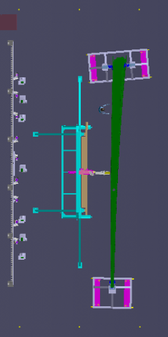
100 ft
Table 6’ X 2’6”
Locker 4’ X 2’
Current 02/19/2018
Electrical Panel
50 ft
Server Rack

Slide 43
Rail Length Requirement
Z_{world}
FOV
Surface Length
39’2”
X_{world}
baseline
Rail Carriage: SurfaceLength + 0.5*baseline + margin
~45’

Slide 44
Linear Scanning Requirement
Entire scan in 5 minutes
Assuming 6-inch moves, that’s about 3.7 seconds per move
At 1:1 move:image ratio, that’s 1.6 seconds to move 6 inches and 1.6 seconds to collect imagery

